Slide 1

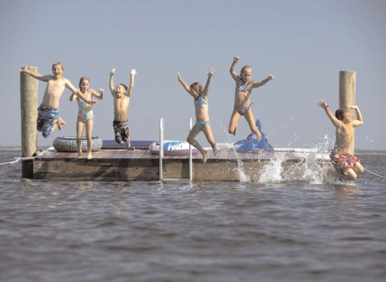


Measure M2 Environmental Cleanup Program
Taxpayers Oversight Committee Aug 9, 2011
Notes:
Good afternoon, I am here to give you an overview and update on the Measure M (M2) Environmental Cleanup Program also known as the Water Quality Program.
This program encompasses 2 percent of annual gross M2 revenues that will be allocated on a competitive basis for water quality improvement projects that have a transportation nexus.
Based on the recent M2 revenue forecasts, over $300 million dollars may be available over 30 years.

Slide 2
Background
Measure M2 (M2) - Water Quality Program
    Transportation related
    Not to supplant funding or mitigation
    Competitive process
    Eligibility
    Capital improvements
Notes:
1. Measure M2 has a Water Quality program that provides competitive funds for water quality improvement projects.
2. The Water Quality was included as an Early Action Plan project in Summer 2007.
3. The OCTA Board designated a 14-member allocation committee, responsible for the program development and making funding recommendations. The Allocation Committee is represented by various stakeholders from the water quality community. The members include Caltrans, the county, water/wastewater pubic entities, academia, private/nonprofit environmental entities, and the RWQCBs.
4. There are M2 Ordinance specified requirements for this Program
Funds will be awarded to projects that improve water quality that have a nexus to transportation-related activities. These could include operation, construction, and maintenance of public roads, highways, and other ground transportation systems
Competitive grant process to ensure that cost-effective projects are funded
Projects that demonstrate high cost-benefit will be more competitive.
Can’t replace funding in existing programs (freeway and road programs, water quality programs, etc.)
Eligibility
Eligible jurisdictions for funding include Orange County cities and the County of Orange
Third parties, such as water and wastewater public entities, environmental organizations, and nonprofit 501(c)(3) are eligible, however; these entities must partner with a city and/or the County.

Slide 3
May 2010 Board of Directors Actions
Two-tier grant funding approach
Tier 1
  Up to $19.5 million on “pay-as-you-go” basis available from fiscal year (FY) 2011-12 to FY 2017-18
  Funding guidelines for Tier 1 Grant Program
Tier 2
  Up to $38 million available through FY 2014-15
  Planning and research study for the development of the Tier 2 funding guidelines
Notes:
In May 2010, the OCTA Board approved a two-tier grant funding approach for this Program.
The Board has approved a funding plan of up to $19.5 million on a pay-as-you-go basis from FY 2011-12 through FY 2017-18.
Based on a countywide survey, it is estimated that the Tier 1 Grant Program could be completed by FY 2017-18. Matching funds from the eligible agencies will be required at 25 percent of the total project costs.
The Board has also approved that the Tier 2 Grant Program be funded beginning in FY 2011-12 via bonding with up to $38 million allocated through FY 2014-15. Beyond FY 2014-15, funding will be based on a pay-as-you-go basis. To further augment the amount of total funding available to all interested eligible jurisdictions, a 50 percent matching fund will be required of the total project costs.

Slide 4
Tier 1 Funding Approach
Quick delivery and can be completed in a single year
Focused on more visible forms of pollutants (trash) and landscape runoff
$100,000 cap per project; maximum $500,000 available per agency
Notes:
Below are some specifics for the Tier 1 program
Funding is intended to be more localized
Intended for catch basin related BMPs such as screens, filters, and inserts
Designed to mitigate the more visible forms of pollutants (litter/debris)
Depending on the jurisdiction's need, may be completed in a single year or sooner.
Finalizing a consolidated purchasing program with the County of Orange that would enable OCTA to increase our buying power by purchasing in bulk.

Slide 5
Summary of Tier 1 Call for Projects
Call for projects February 18 – April 18, 2011
47 Total applications
  Recommended funding for 34 projects - $2,861,786 total recommended funding

Slide 6
August 2011 Board of Directors Actions
Approved Tier 1 programming recommendations for M2 Environmental Cleanup Program
Authorized allocation of funds through the Comprehensive Transportation Funding Program master funding agreement
6

Slide 7
Summary of Tier 1 Call for Projects
Projects Included:
  Automatic Retractable Screens
  Continuous Deflection Separators
  Linear Radial Gross Solid Removal Devices
  Retrofit irrigation systems to reduce runoff
  Marina Trash Skimmer
Notes:
Projects Included:
Automatic Retractable Screen (ARS ) 20 projects
Irrigation System to retrofit to reduce runoff 6 Projects
Continuous Deflection Separator (CDS) 5 projects
Linear Radial Gross Solid Removal Device (GSRD) 2 projects
Marina Trash Skimmer 1 project

Slide 8
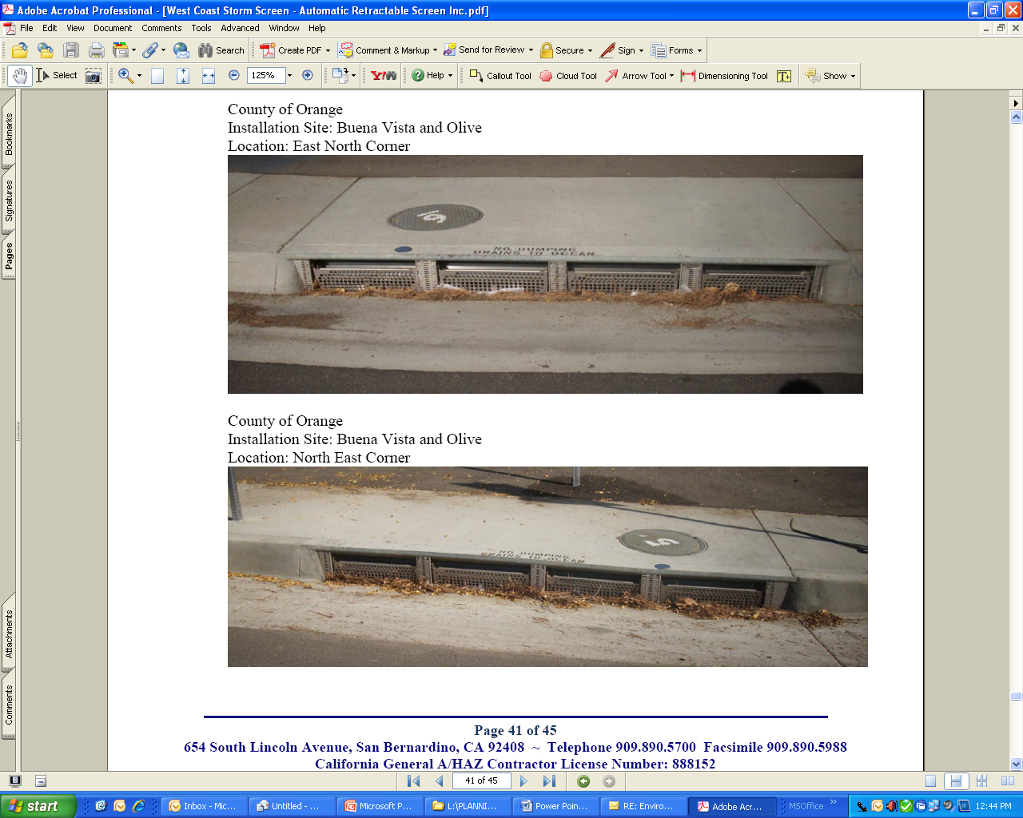
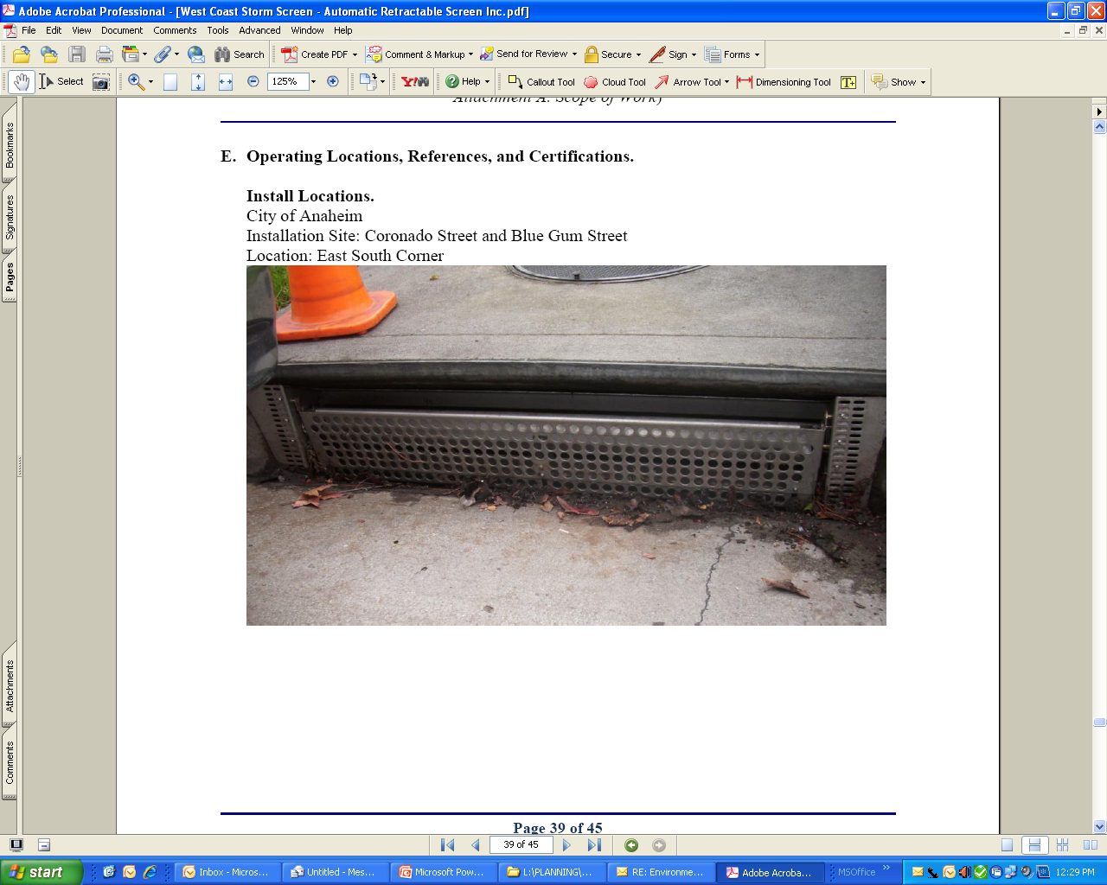
Summary of Tier 1 Call for Projects
  Automatic Retractable Screen
Notes:
Projects Included:
Automatic Retractable Screen (ARS ) 20 projects
Marina Trash Skimmer 1 project
Continuous Deflection Separator (CDS) 5 projects
Linear Radial Gross Solid Removal Device (GSRD) 2 projects
Irrigation System to retrofit to reduce runoff 6 Projects

Slide 9
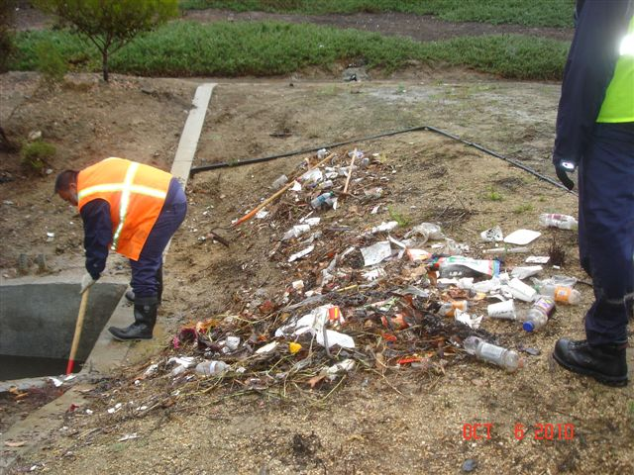
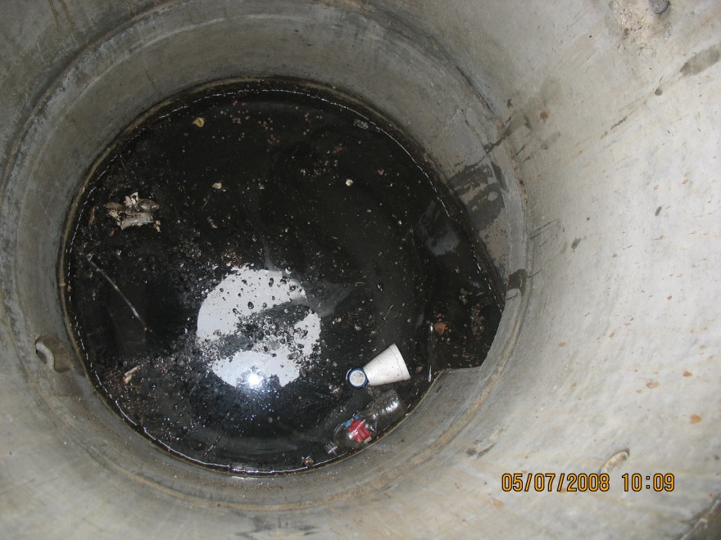
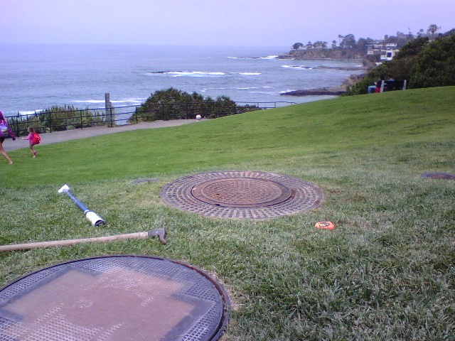
Summary of Tier 1 Call for Projects
  Continuous Deflection Separator
Notes:
Projects Included:
Automatic Retractable Screen (ARS ) 20 projects
Marina Trash Skimmer 1 project
Continuous Deflection Separator (CDS) 5 projects
Linear Radial Gross Solid Removal Device (GSRD) 2 projects
Irrigation System to retrofit to reduce runoff 6 Projects

Slide 10
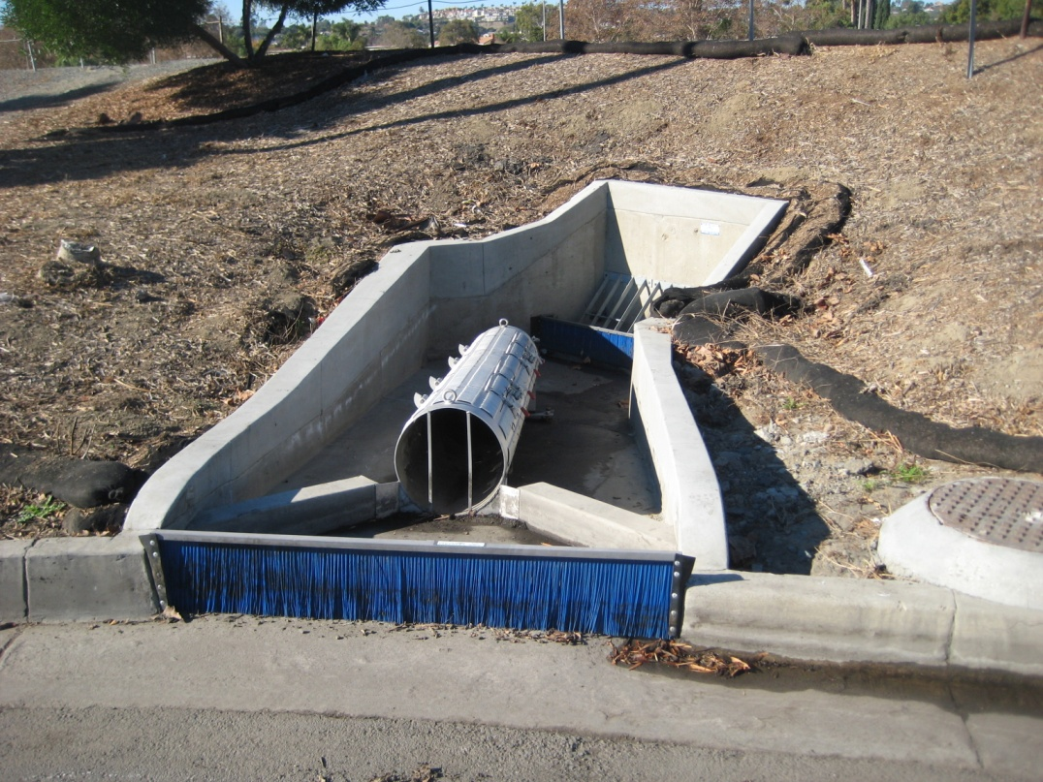
Summary of Tier 1 Call for Projects
  Linear Radial Gross Solid Removal Device

Slide 11
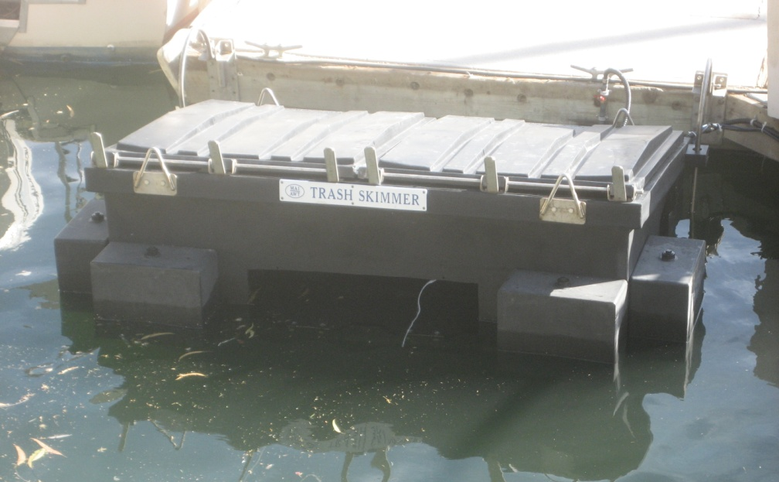
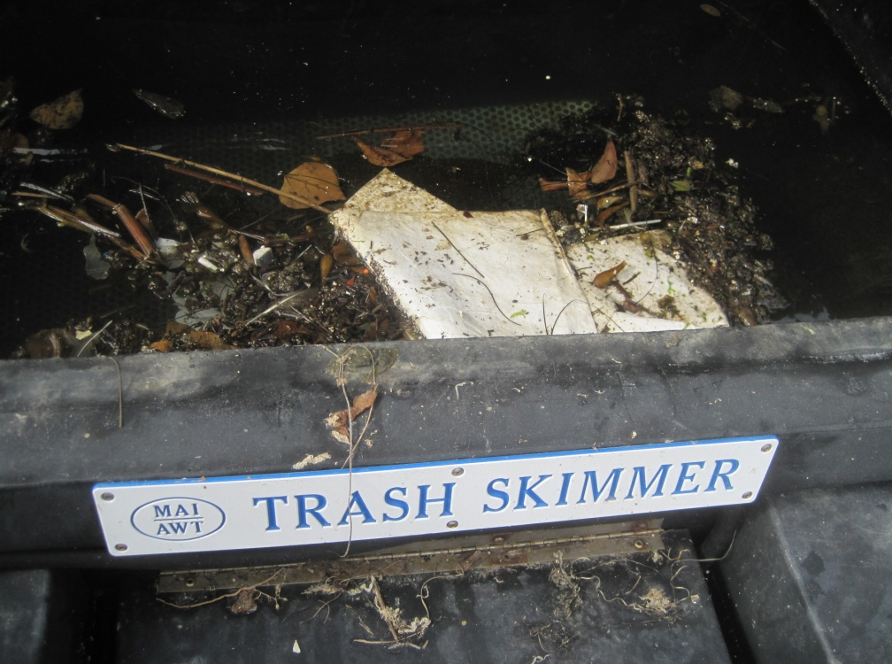
Summary of Tier 1 Call for Projects
  Marina Trash Skimmer
Notes:
Projects Included:
Automatic Retractable Screen (ARS ) 20 projects
Marina Trash Skimmer 1 project
Continuous Deflection Separator (CDS) 5 projects
Linear Radial Gross Solid Removal Device (GSRD) 2 projects
Irrigation System to retrofit to reduce runoff 6 Projects

Slide 12
Next Steps
Execute agreement letters with agencies
Monitor project status through semi-annual review process
Spring 2012 – issue next Tier 1 Call for Projects
12
Notes:
Execute agreement letters from all the applicants
Monitor project review and delivery status through semi-annual review process
Issue next Tier 1 Call for Projects – Spring 2012
Upon completion of Tier 2 study, staff will seek approval of the Tier 2 guidelines
Issue Tier 2 Call for Projects – Summer 2012

